Slide 1
Quantum Logic Gates on Time-Bin Encoded Photonic Qubits
Ivanna Boras
December 4, 2023

Slide 2
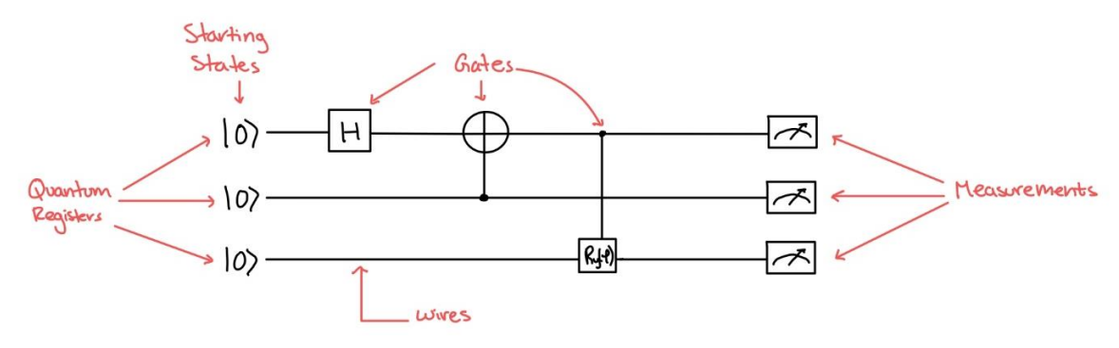
Quantum Logic Gates
Useful for Quantum Simulations
Notes:
Quantum simulators permit the study of a quantum system in a programmable fashion

Slide 3
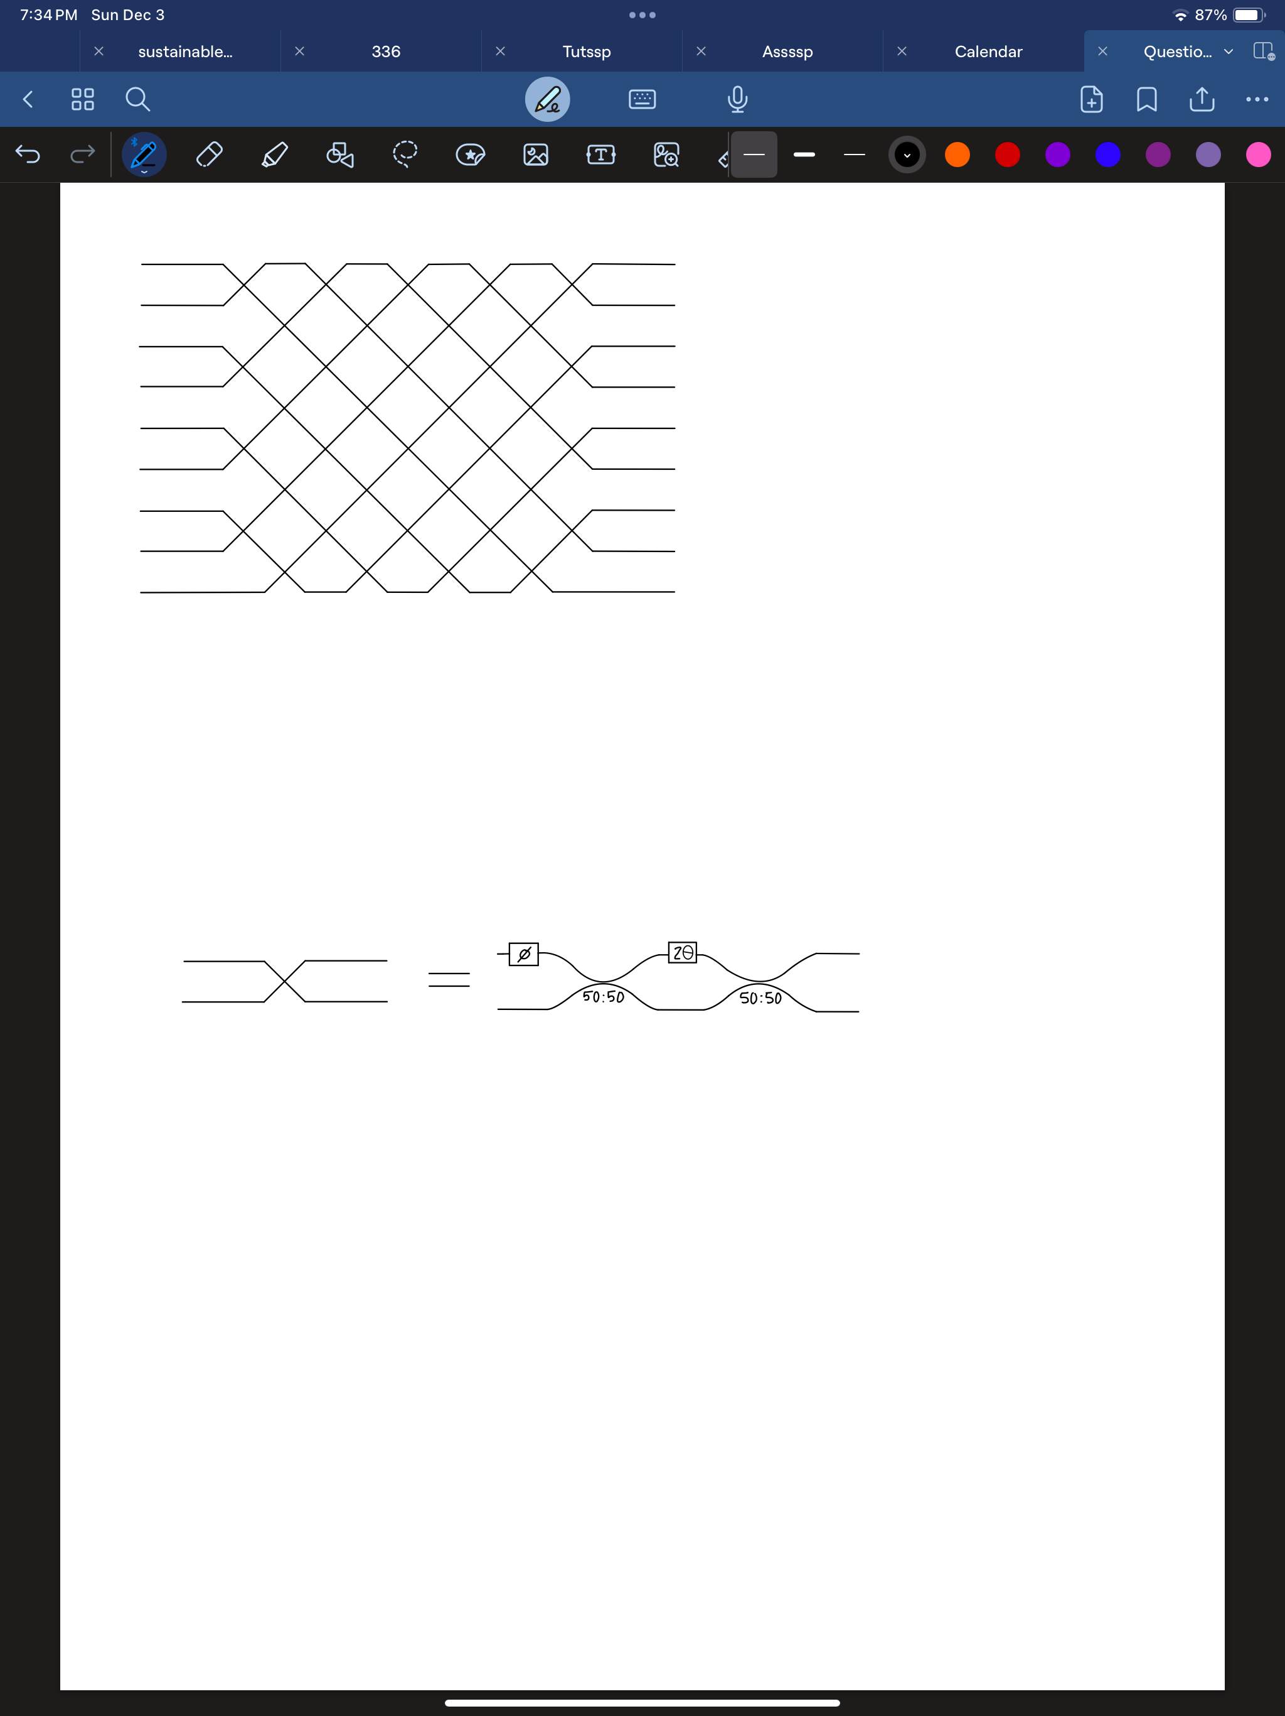
Building Logic Gates
Simplification of previous process
- Still uses a lot of space
- Could be better!
W. Clements et al., Optica, vol. 3, pp. 1460- 1465, 2016

Slide 4
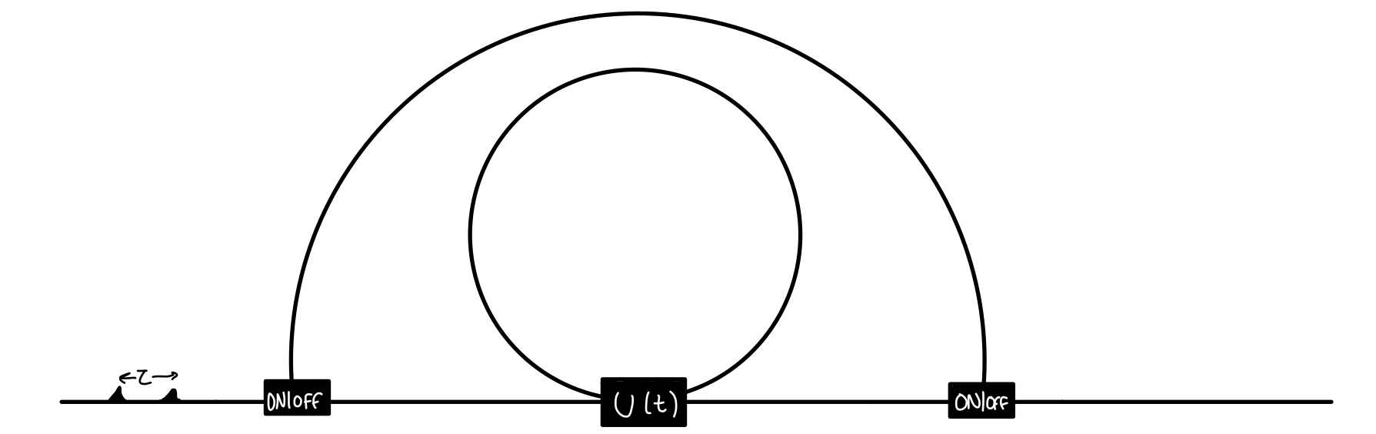
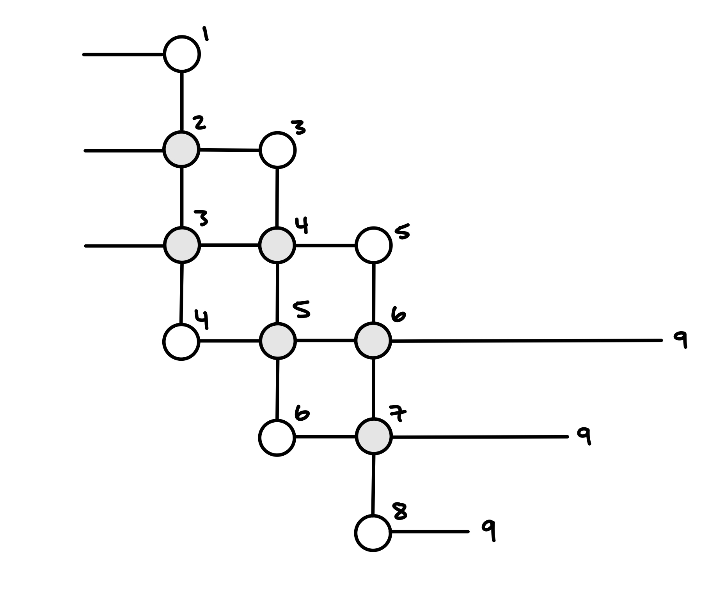
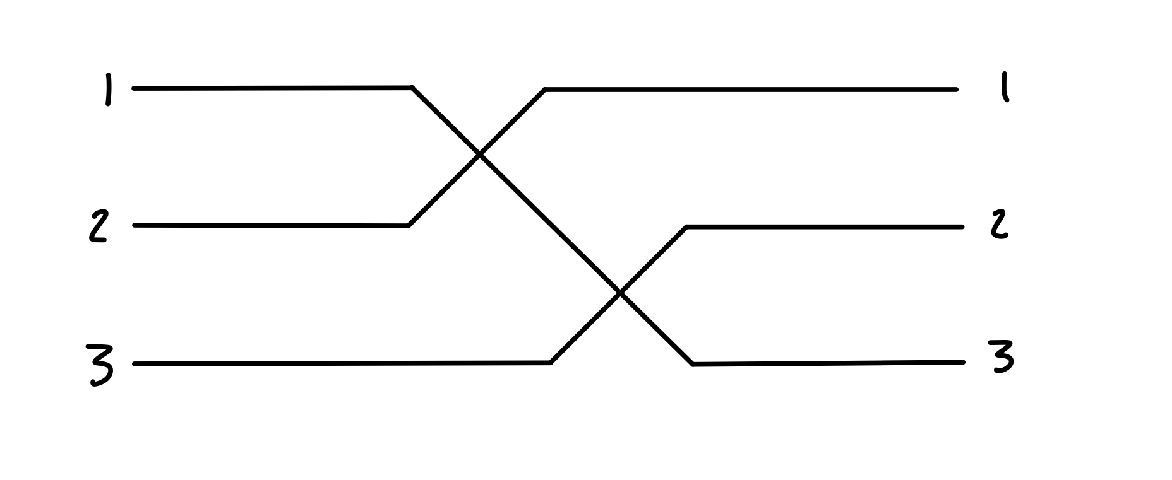
Motivation
K. R. Motes, A. Gilchrist, J. P. Dowling, and P. P. Rohde, “Scalable boson-sampling with time-bin encoding using a loop-based architecture,” Physical Review Letters, vol. 113, p. 120501, Sept. 2014

Slide 5
Goals
Create a CNOT gate
Integrate losses
Fiber
Components
Time-Jitter
K. R. Motes, J. P. Dowling, A. Gilchrist, and P. P. Rohde, “Implementing Boson-Sampling with time-bin encoding: Analysis of loss, mode mismatch, and time jitter,” Physical Review A, vol. 92, p. 052319, Nov. 2015.

Slide 6
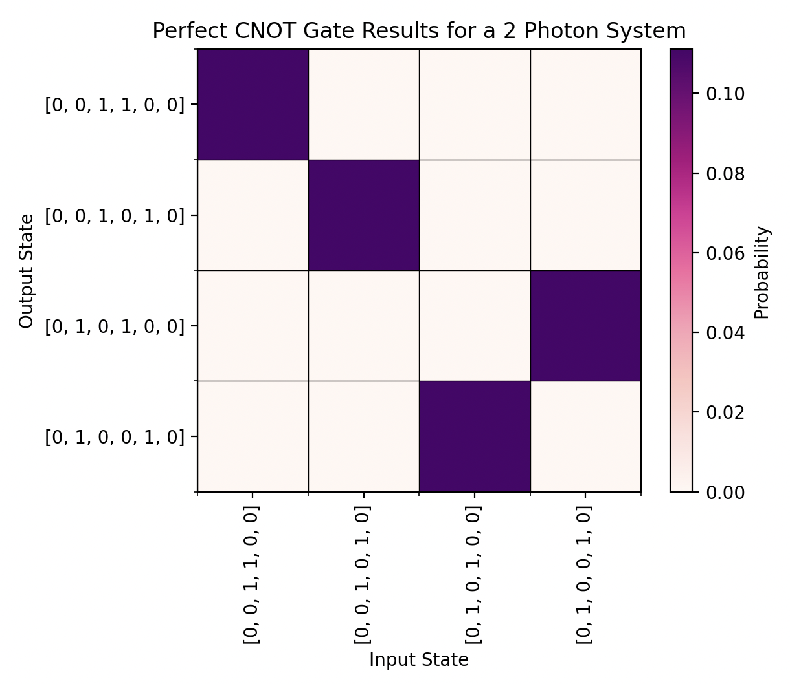
Progress and Methodology
Unitary matrix to phase shifts conversion
Phase shift extraction
Research into other systems
Frequency, Polarization
Perfect CNOT

Slide 7

Project Constraints
Computational Power
Time
Cost
Runtime and Data
Component Switching Time

Slide 8
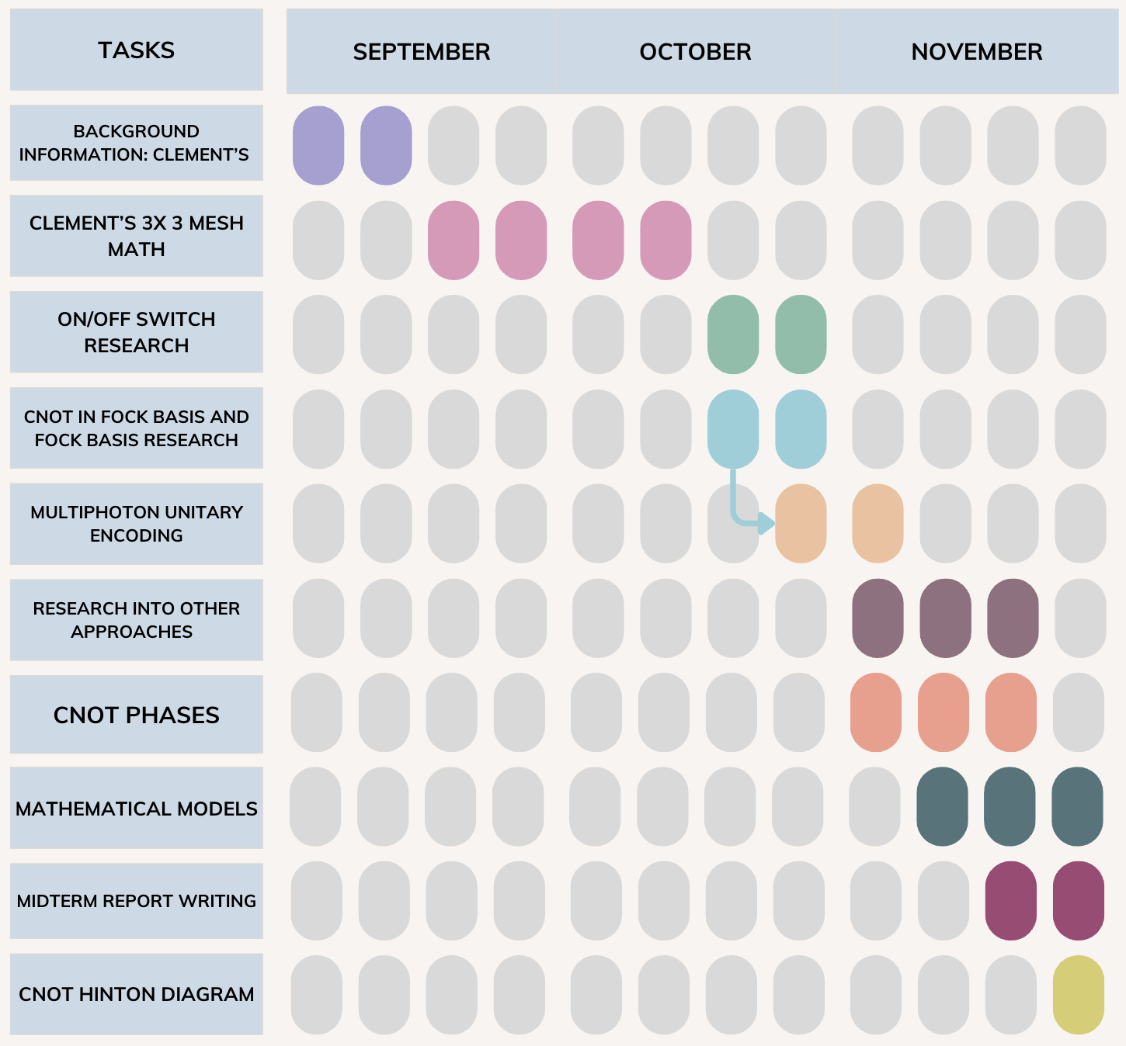
Project time-line

Slide 9
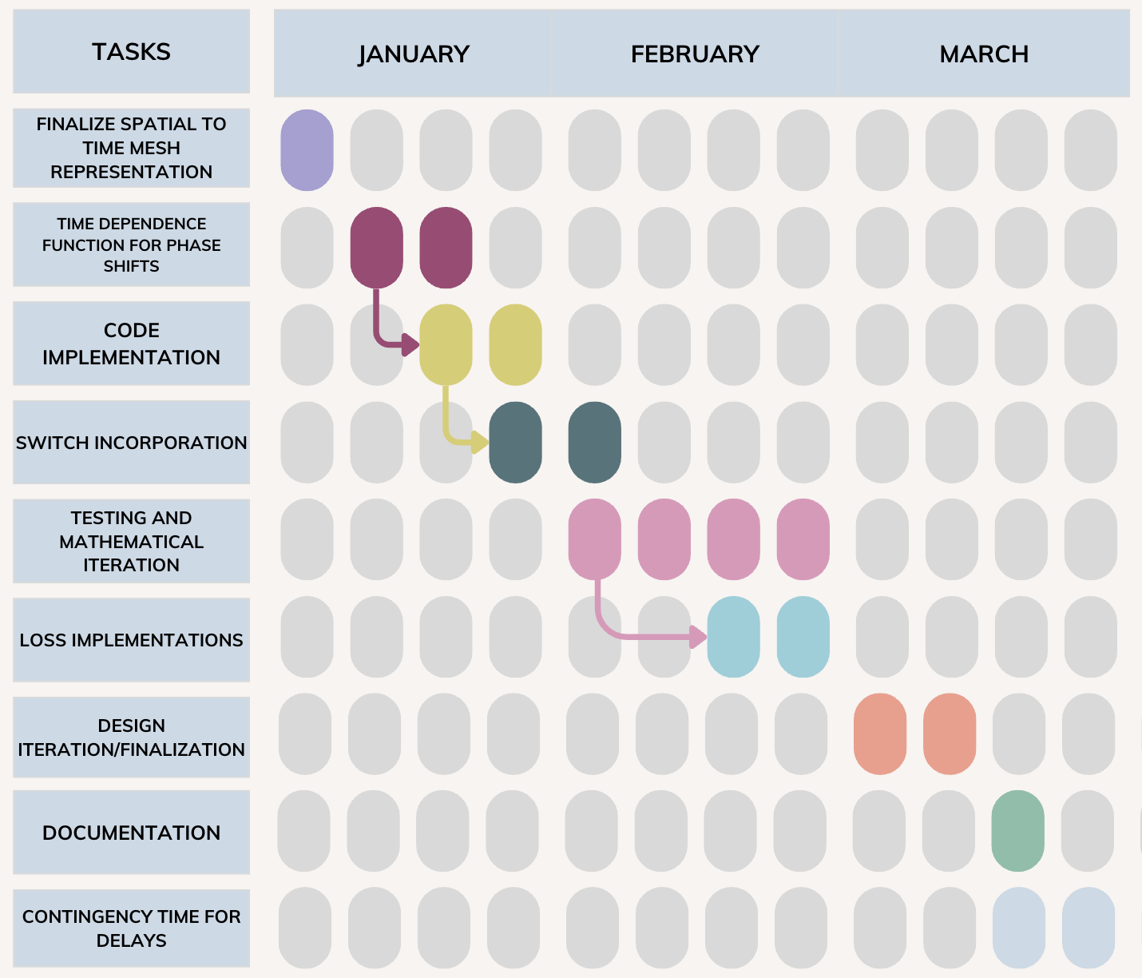
Project time-line

Slide 10
Questions?
Notes:
The interferometer has to keep a stable phase, which means that the path length difference must vary by much less than the wavelength of light during the experiment.

